Slide 1


Final Presentation
TEAM 1A
Member Name
Nabiha Orchi (Project Scribe)
Sai Lochan (Team Lead)
Adewale Adeniji (Project Manager)
Shreya Wani (Project Lead)
Aisha Hassan
Haruna Yusuf
Derrick Addo

Slide 2
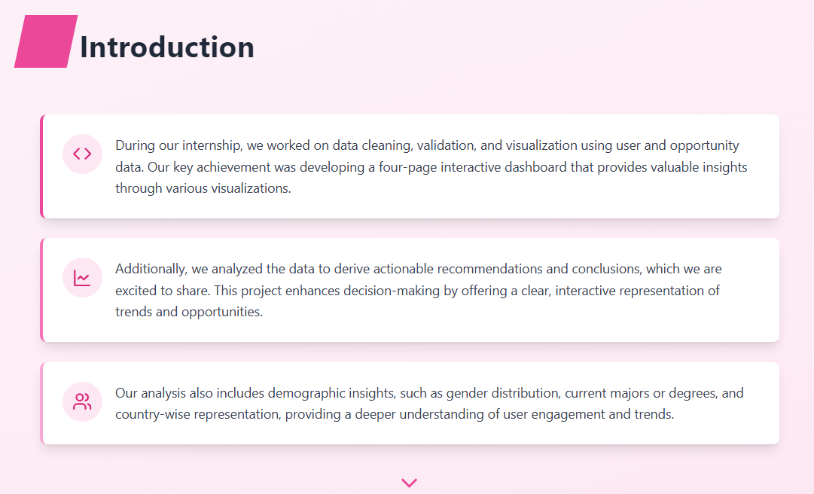

Slide 3
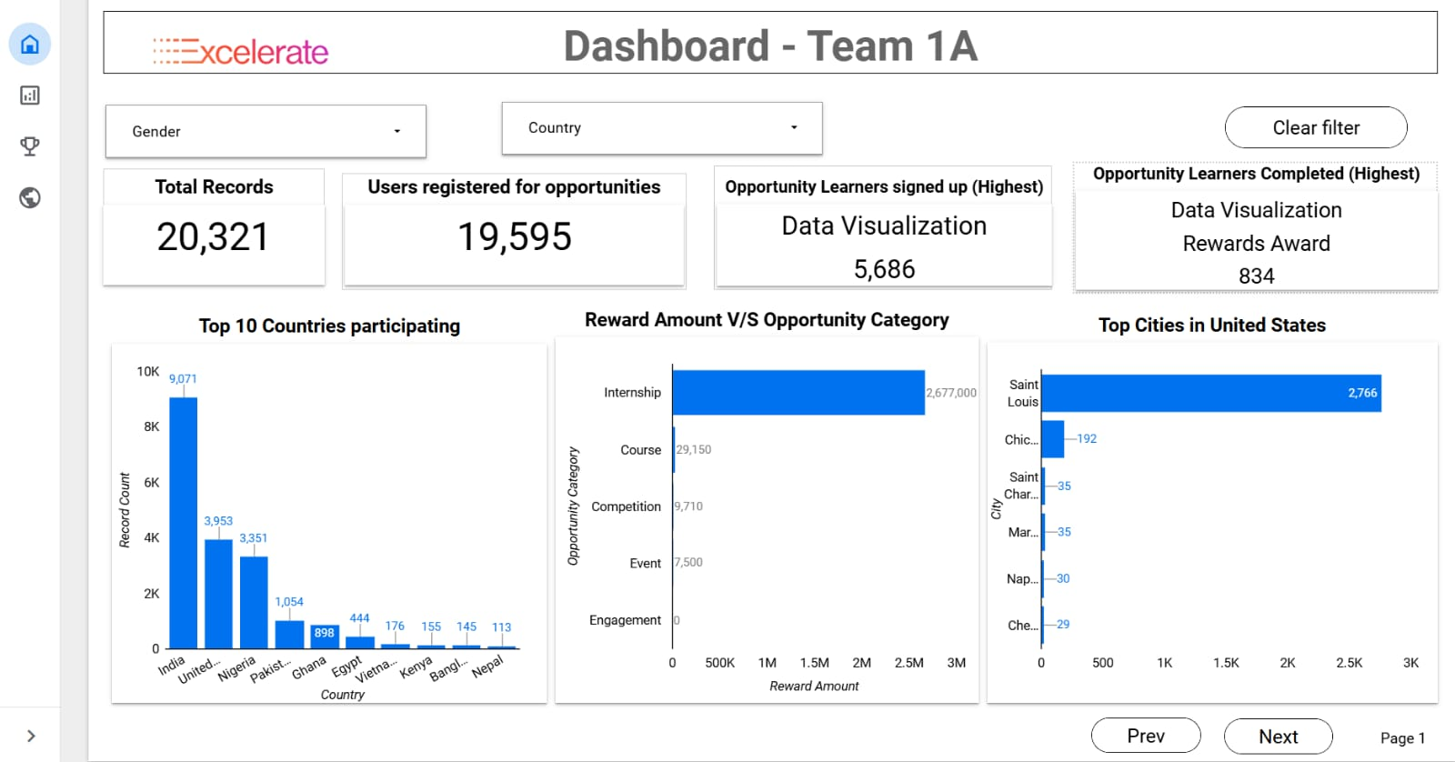
Dashboard Overview

Slide 4
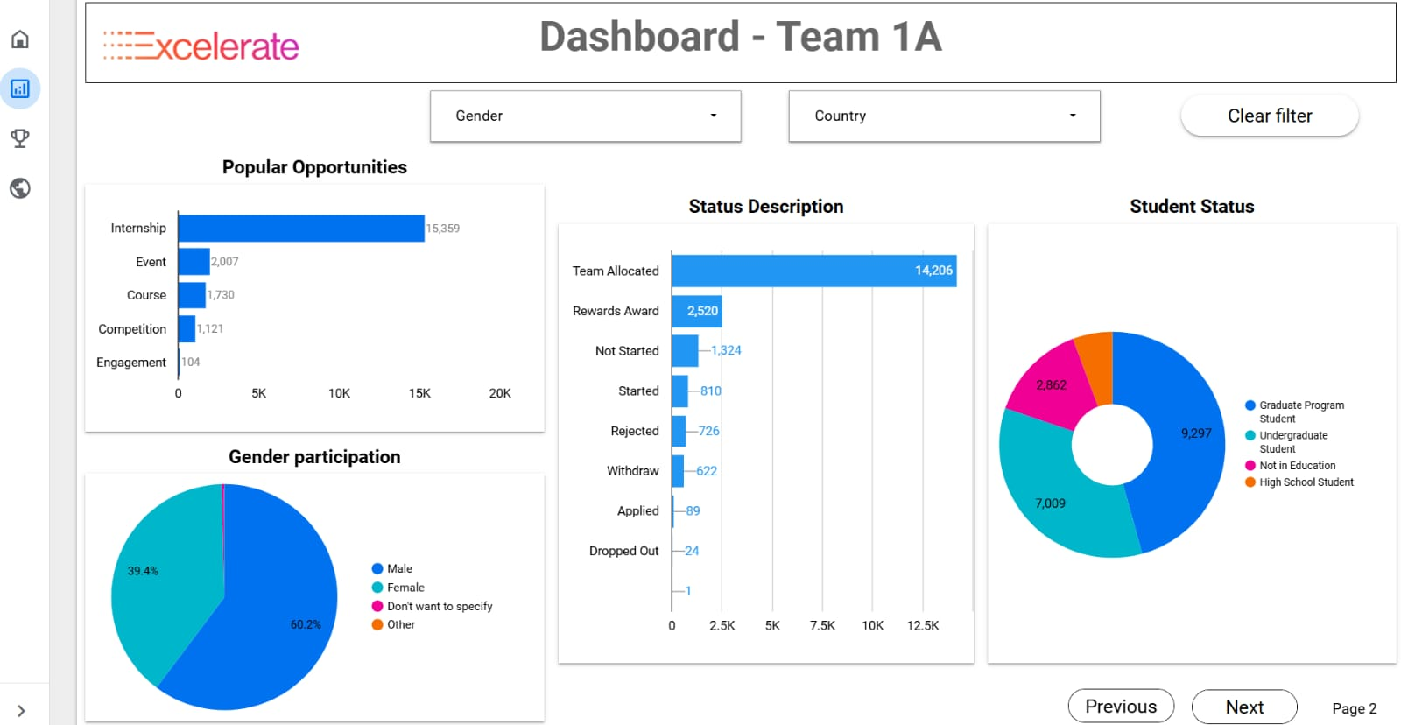
User Engagement & Demographics

Slide 5
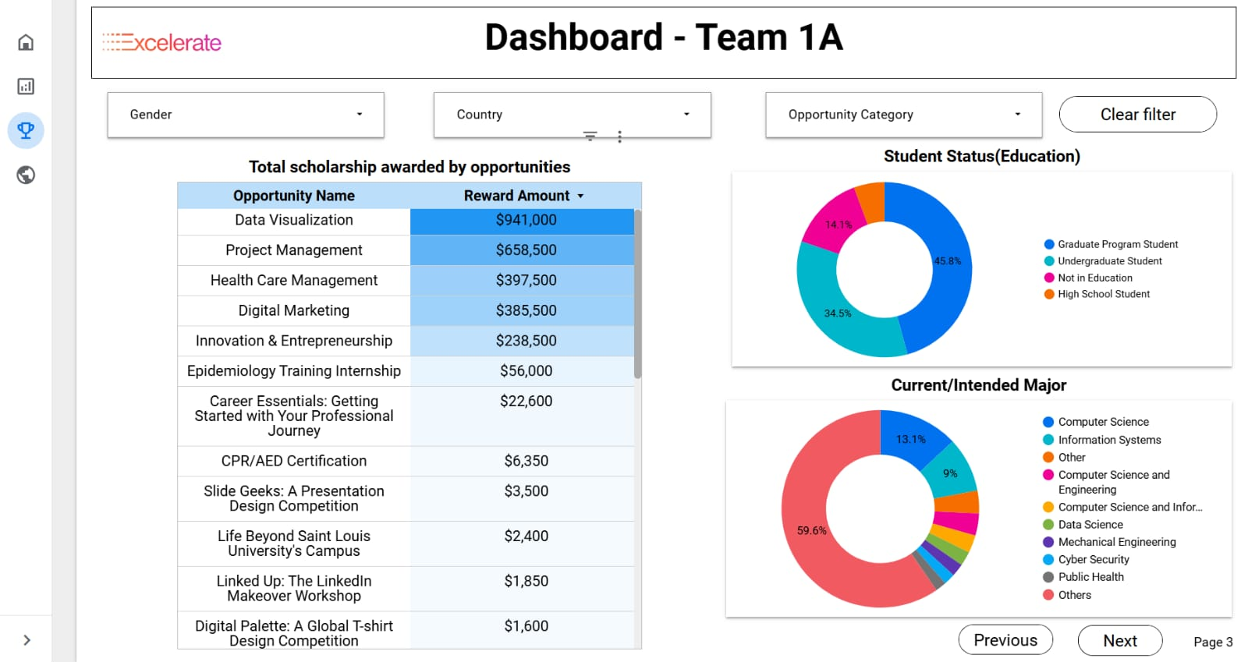
Scholarship Awards & Skills Development

Slide 6
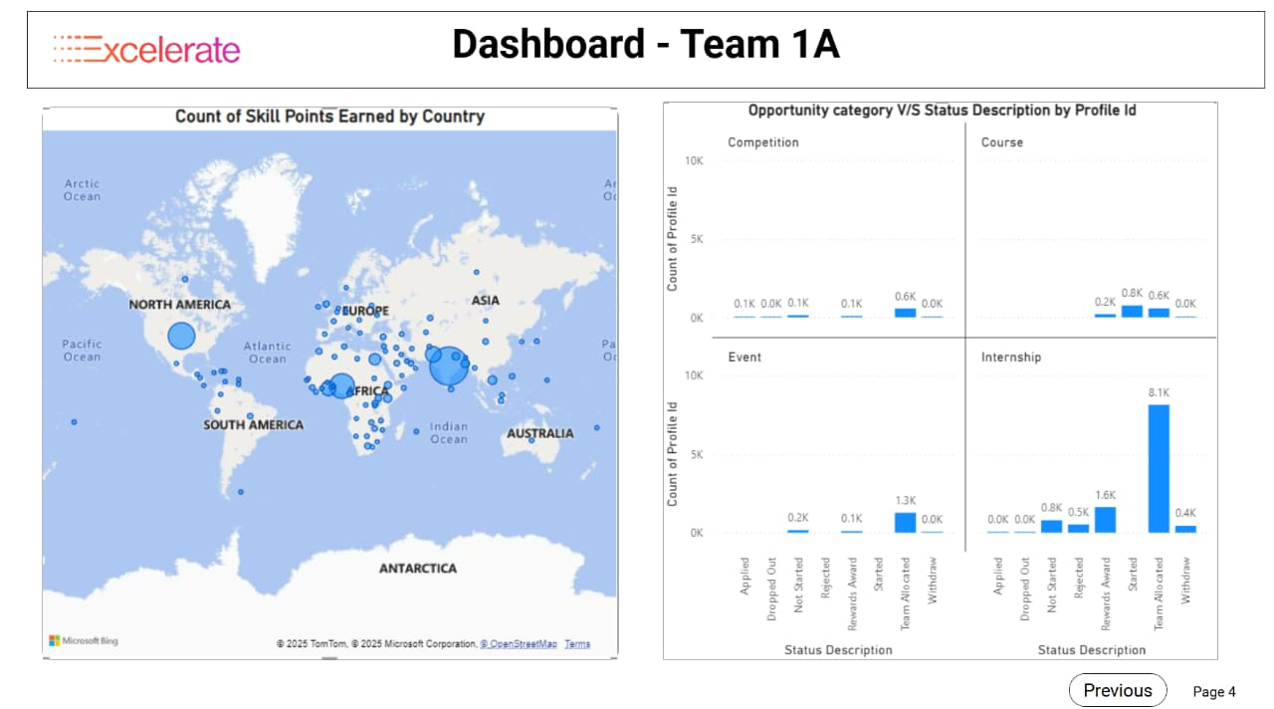
Scholarship Awards & Skills Development

Slide 7
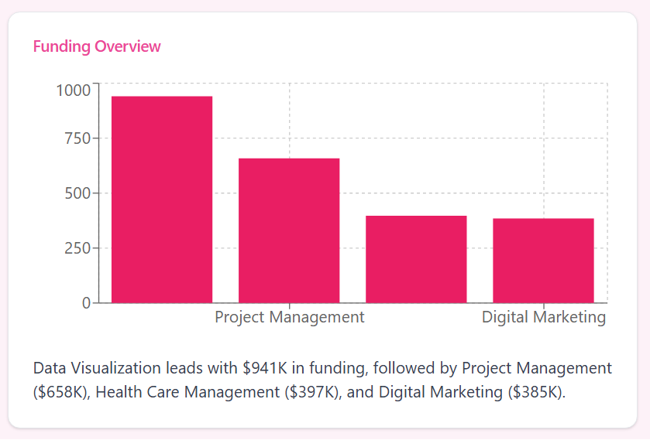
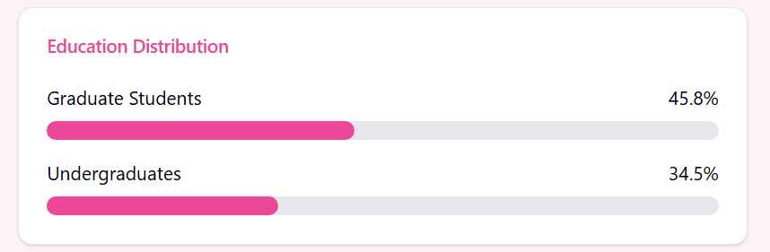
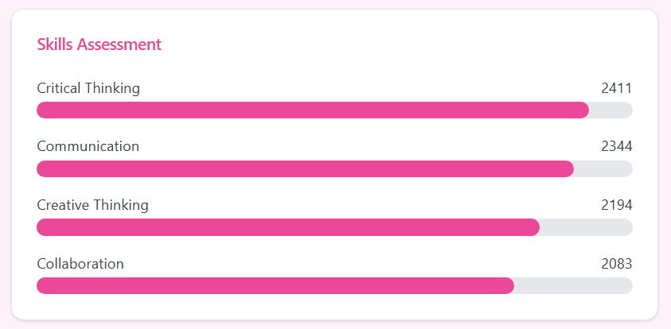
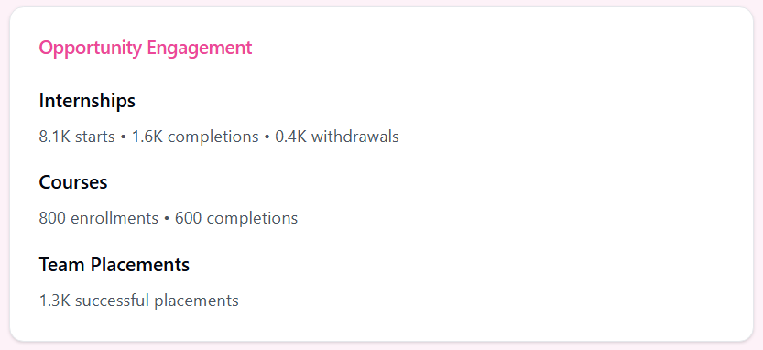
Dashboard Insights Summary

Slide 8
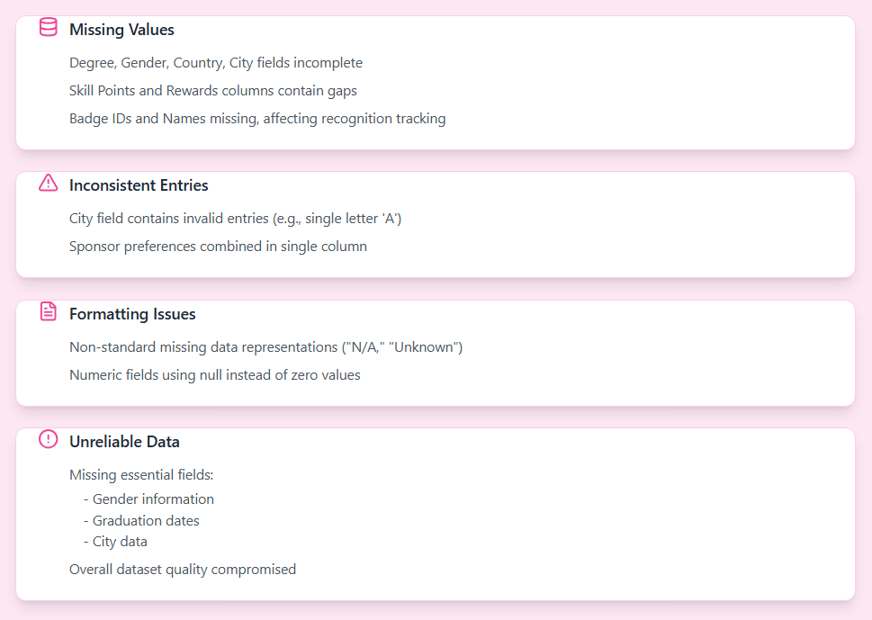
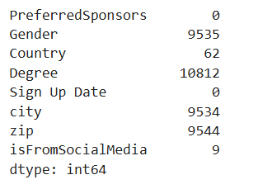
Data Cleaning Challenges
Fig : User Dataset NULL Values

Slide 9
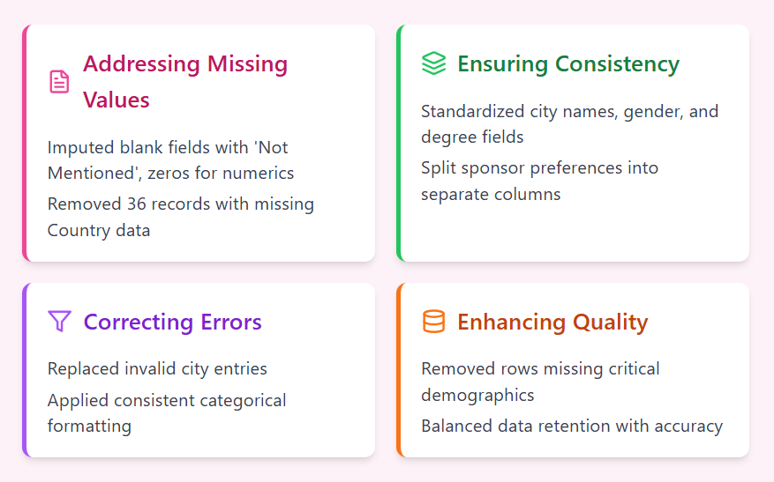
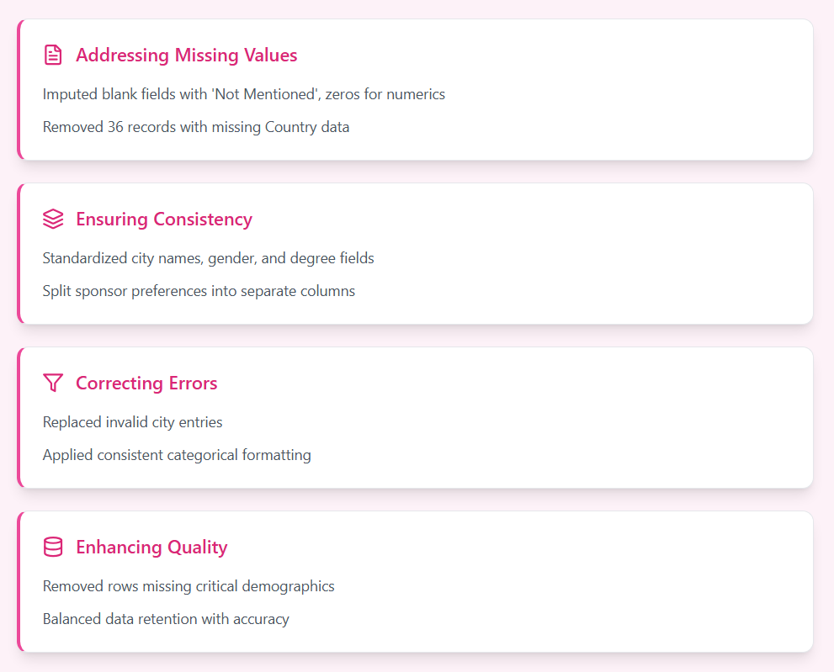
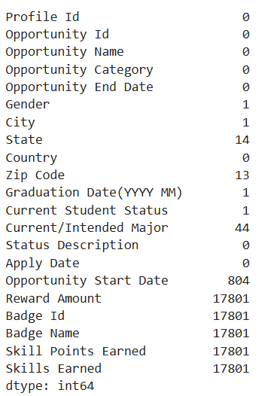
Data Cleaning Solutions
Fig: Opportunity Dataset NULL values

Slide 10
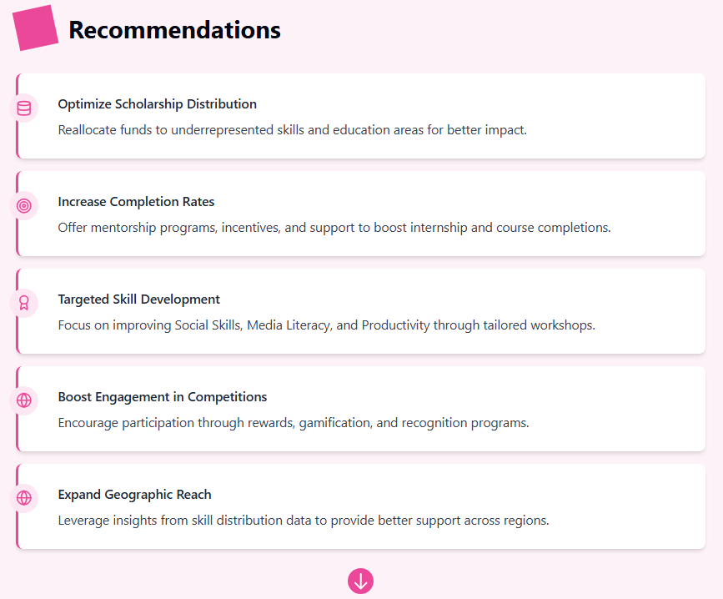

Slide 11
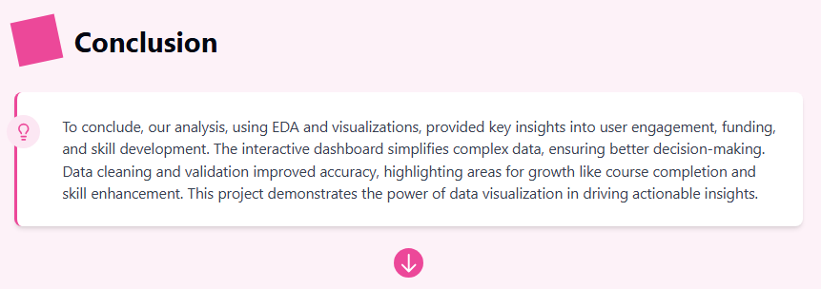

Slide 12



